Slide 1
AI
Indirect modeling
Nov 2021

Slide 2
Objectives
Explore methodology in improving AI modeling of relatively sparse PK/PD data
Compare the applicability of AI for the IDR with two different delays in PK/PD

Slide 3
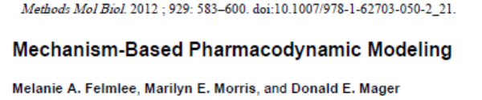
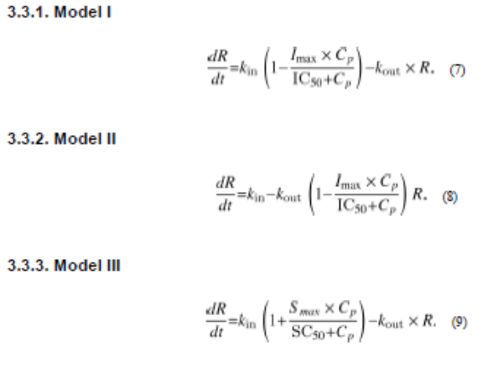
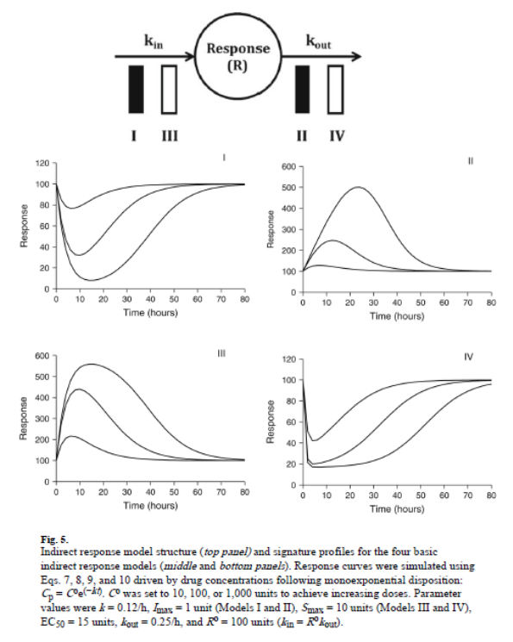
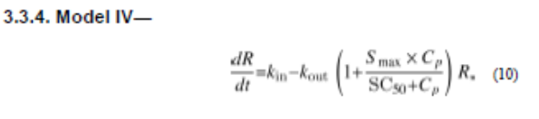
Basics of four indirect models

Slide 4
Model I in NONMEM
Oral dose
A(1)
Ka
A(2)
IC50
V=THETA(1)*EXP(ETA(1));
KIN = KOUT*100
F3=KIN/KOUT
DADT(1)=-KA*A(1)
DADT(2)=KA*A(1)-K*A(2)
CONC=A(2)*1000000/V
DADT(3)=KIN*(1-CONC/(CONC+I50))-KOUT*A(3)
Y=IPRED+IPRED*ERR(1)
25000 FIXED; V/F
0.2 FIXED ; V/F error
0.2 FIXED ; IPRED residual error
SIM = 100
Kin
K
A(3)
Kout
A(1): drug in GI tract
A(2): drug in plasma measured
A(3): drug effect measured
Ka: first-order rate constant of absorption, 1/hr
K: first-order rate constant of elimination, 1/hr
IC50: drug concentration inhibiting 50% of Kin
Kin: zero-order rate constant of generating A(3), PD effect
Kout: First-order rate constant of elimination of PD effect

Slide 5
IC50=1
Kout=0.1
Ka=0.1
IC50=10
Kout=1
K=0.1
Ka=1
Combinations = 16
IDR
K=1
V/F=25000 mL/kg
Dose=0.03, 0.1, 0.3, 1, 10, 30 mg/kg

Slide 6
Combinations | K | Ka | Kout | IC50
1 | 0.1 | 0.1 | 0.1 | 1
2 | 0.1 | 0.1 | 0.1 | 10
3 | 0.1 | 0.1 | 1 | 1
4 | 0.1 | 0.1 | 1 | 10
5 | 0.1 | 1 | 0.1 | 1
6 | 0.1 | 1 | 0.1 | 10
7 | 0.1 | 1 | 1 | 1
8 | 0.1 | 1 | 1 | 10
9 | 1 | 0.1 | 0.1 | 1
10 | 1 | 0.1 | 0.1 | 10
11 | 1 | 0.1 | 1 | 1
12 | 1 | 0.1 | 1 | 10
13 | 1 | 1 | 0.1 | 1
14 | 1 | 1 | 0.1 | 10
15 | 1 | 1 | 1 | 1
16 | 1 | 1 | 1 | 10

Slide 7
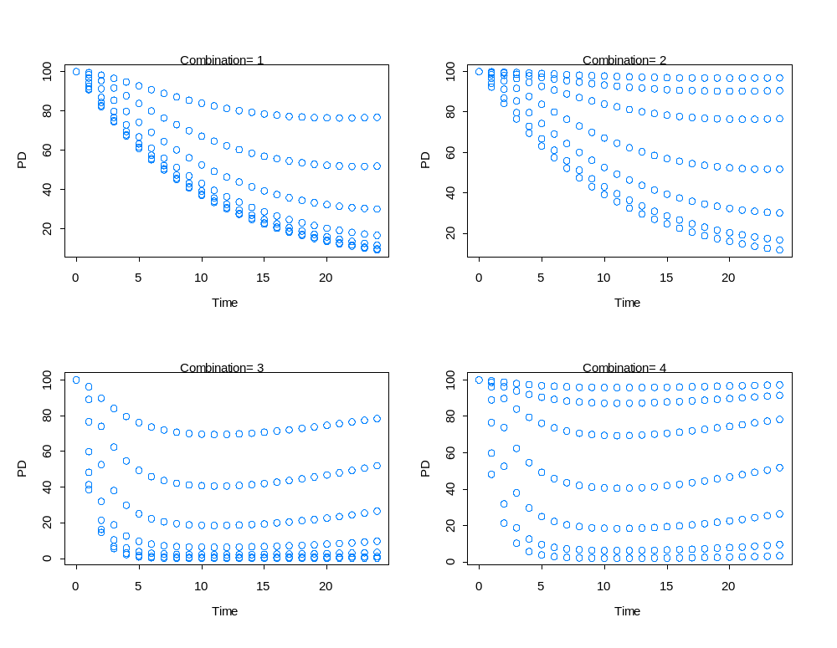

Slide 8
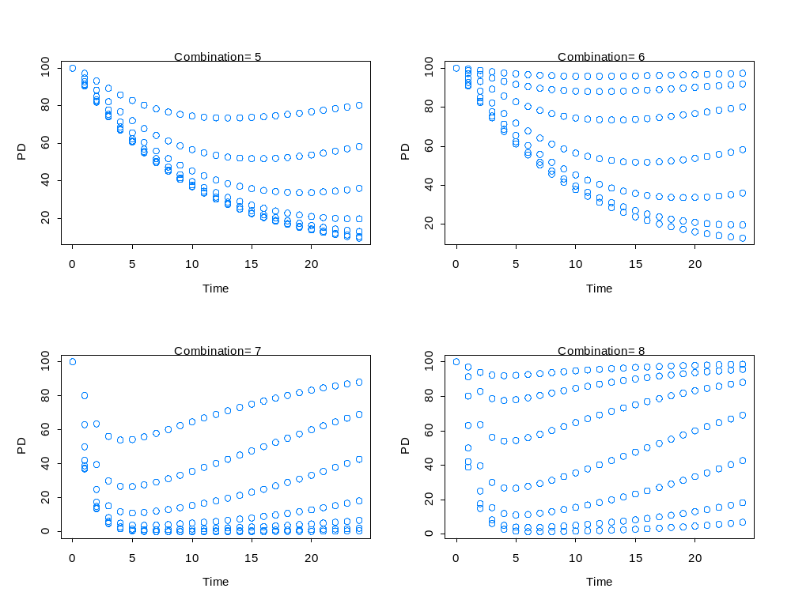

Slide 9
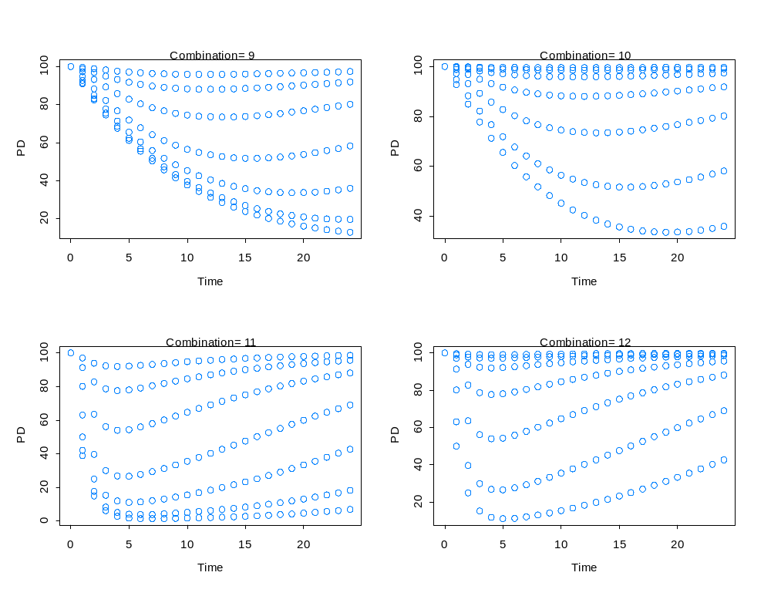

Slide 10
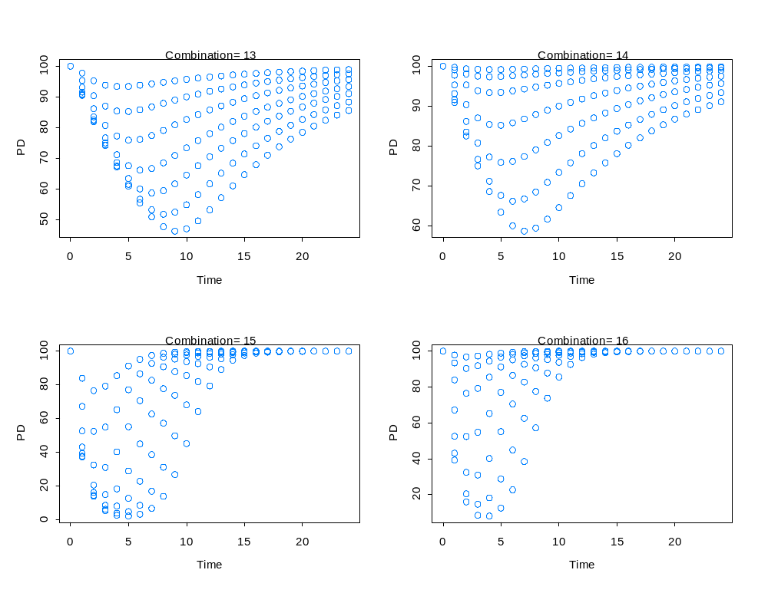

Slide 11
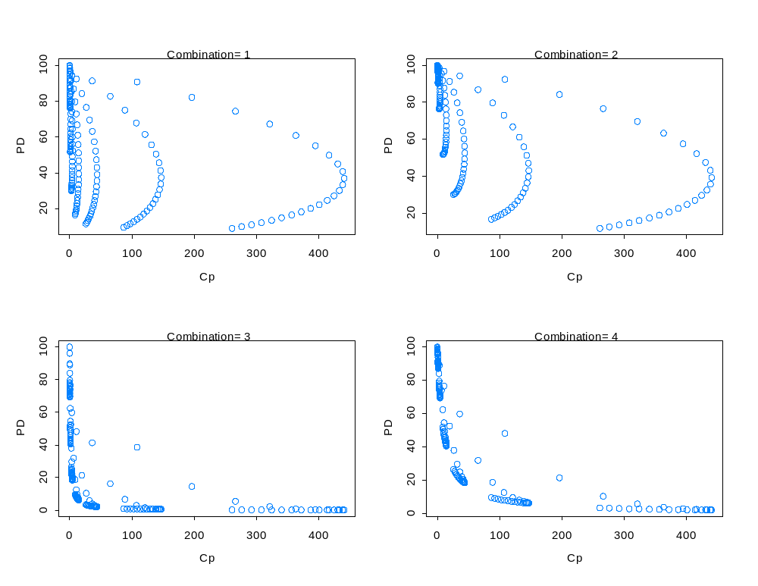
Time = 0 to 24 hr

Slide 12
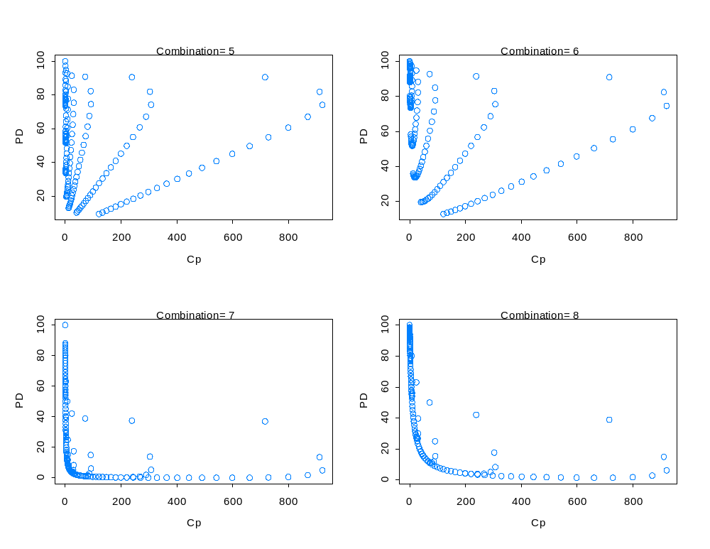
Time = 0 to 24 hr

Slide 13
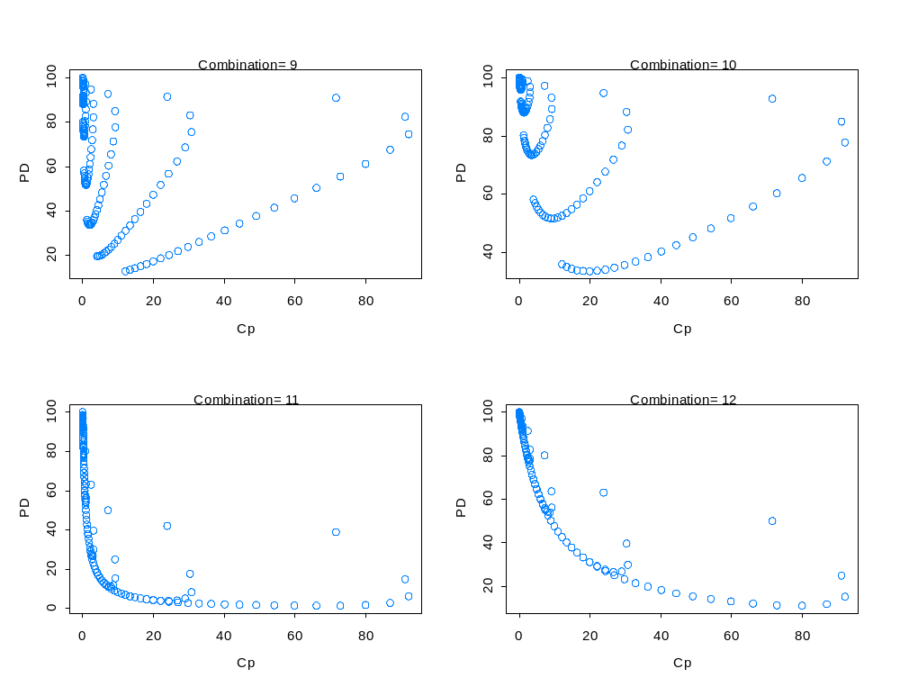
Time = 0 to 24 hr

Slide 14
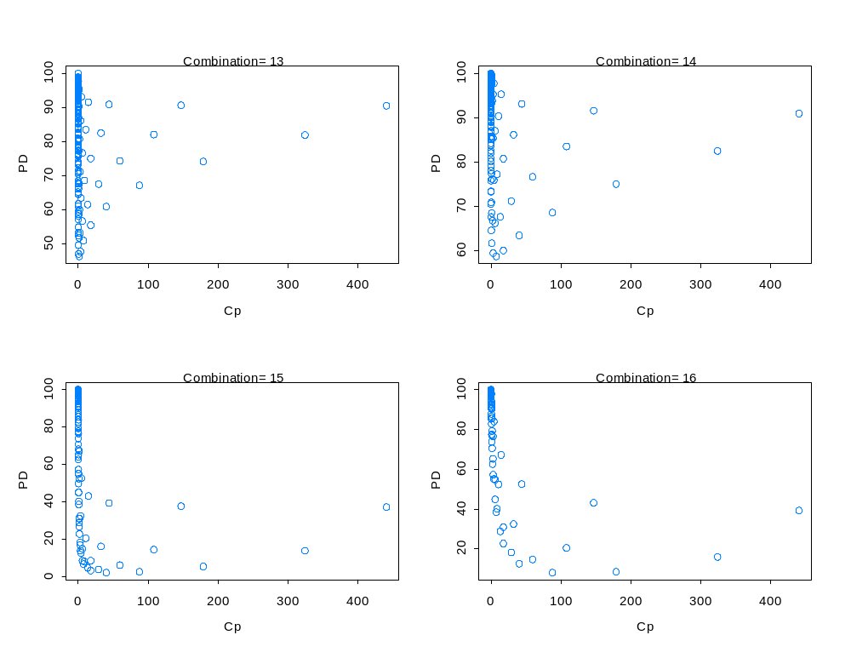
Time = 0 to 24 hr

Slide 15
Methods
Dose regimen and data
Time interval= 4 hr (6 points/day)
7 dose levels
QD for 7 days
PK/PD combinations: Comb 1 and Comb 3
AI methods
  Method 1: LSTM recurrent NN WITHOUT DOSE and TIME
  Method 2: LSTM recurrent NN WITH DOSE and TIME
  Method 3: Gated recurrent unit (GRU) with DOSE and TIME
Evaluations
  Compare AI among three methods for fitting all 7 doses
  Fitting low doses and predicting high doses
  Fitting high doses and predicting high doses
  Fitting mid doses and predicting low and high doses
  Reduce N=6/day further to 4, 8, 12 and 24 hr

